Slide 1

Heart Failure with Mildly Reduced Ejection Fraction: An HFSA Scientific Statement
Wilcox, et al. J Card Fail 2026

Slide 2
Top 10 Take-Home Messages (1/2)
HFmrEF is common — affecting up to 1 in 4 heart failure patients — and the absence of dedicated trial data should not discourage treatment, which generally mirrors GDMT for HFrEF.
HFmrEF more closely resembles HFrEF than HFpEF, with high rates of ischemic heart disease (~50–60%), atrial fibrillation (~35–45%), and diabetes (35–40%).
Some studies have shown that ejection fraction is dynamic. In the Swedish Heart Failure Registry, 37% of patients with HFmrEF transitioned to reduced EF over time — underscoring the importance of longitudinal monitoring.
Patients with EF 41–49% and symptoms of heart failure should be recognized and followed as having HFmrEF — not left in diagnostic limbo.
SGLT2 inhibitors demonstrate consistent benefit across the EF spectrum, including HFmrEF, with a significant reduction in HF hospitalization or cardiovascular death in more than 4,000 HFmrEF participants across EMPEROR-Preserved and DELIVER-HF (HR 0.78; 95% CI 0.67–0.90).

Slide 3
Top 10 Take-Home Messages (2/2)
Guideline-directed medical therapy established for HFrEF — including beta-blockers, ACEi/ARB/ARNI, and MRAs — is appropriate for HFmrEF, supported by subgroup and post-hoc analyses across multiple trials.
Ischemic heart disease is both common (~50–60%) and prognostically important in HFmrEF; evaluation for ischemia and consideration of revascularization may alter EF trajectory and outcomes, but further study is needed.
EF alone is an imperfect measure of myocardial function — assessment should consider chamber remodeling, afterload, ischemic burden, and comorbidities.
Phenotype-specific approaches matter: obesity-related HFmrEF may benefit from GLP-1–based therapies; infiltrative and genetic cardiomyopathies require targeted management beyond standard GDMT.
HFmrEF remains under-studied and under-recognized. Dedicated clinical trials and refined phenotyping are urgently needed to advance the evidence base for this growing patient population.

Slide 4
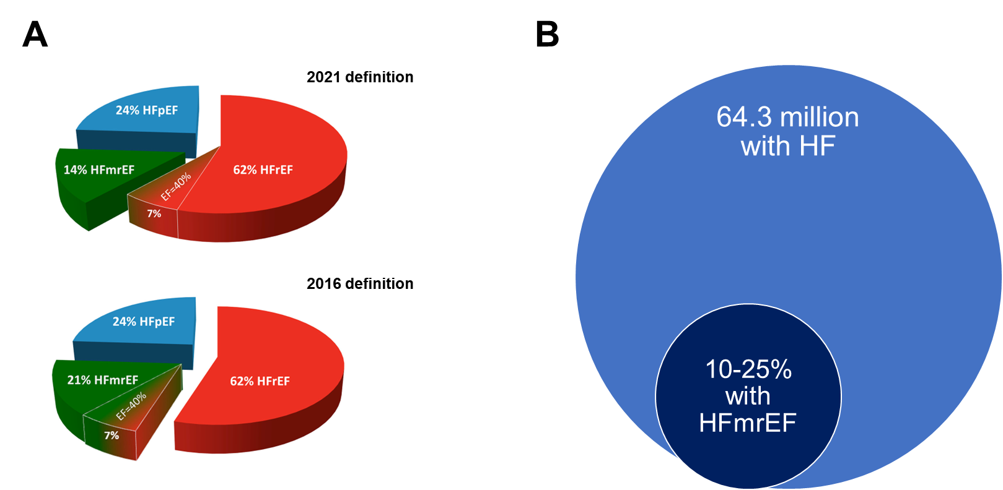
1) HFmrEF is common — affecting up to 1 in 4 heart failure patients — and the absence of dedicated trial data should not discourage treatment, which generally mirrors GDMT for HFrEF.
Figure 1.

Slide 5
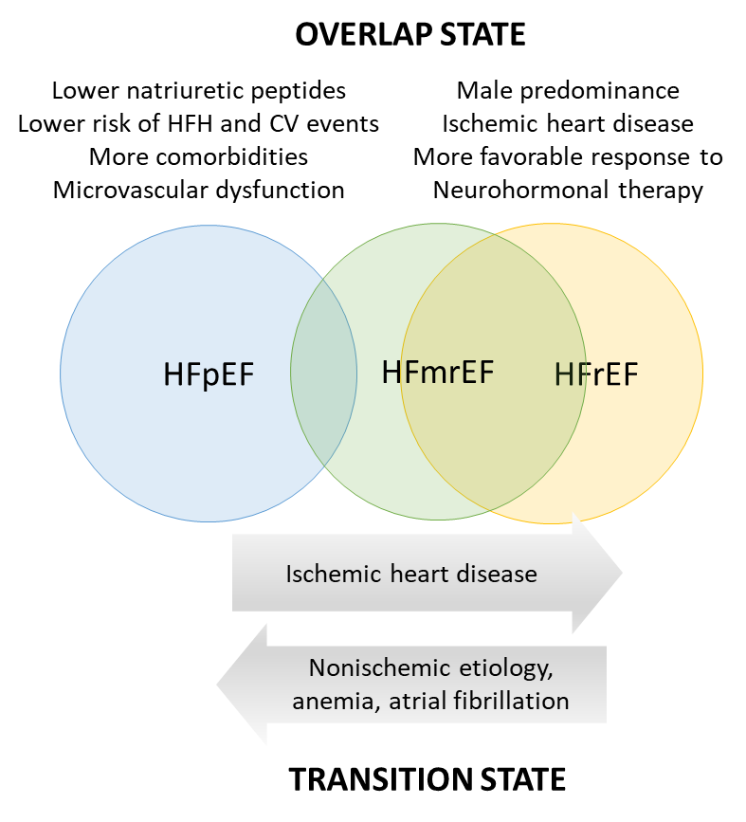
2) HFmrEF more closely resembles HFrEF than HFpEF, with high rates of ischemic heart disease (~50–60%), atrial fibrillation (~35–45%), and diabetes (35–40%).
Figure 3.

Slide 6
3) Some studies have shown that ejection fraction is dynamic. In the Swedish Heart Failure Registry, 37% of patients with HFmrEF transitioned to reduced EF over time — underscoring the importance of longitudinal monitoring.
37%
of patients with HFmrEF transitioned to reduced EF over time.
In the Swedish Heart Failure Registry,

Slide 7
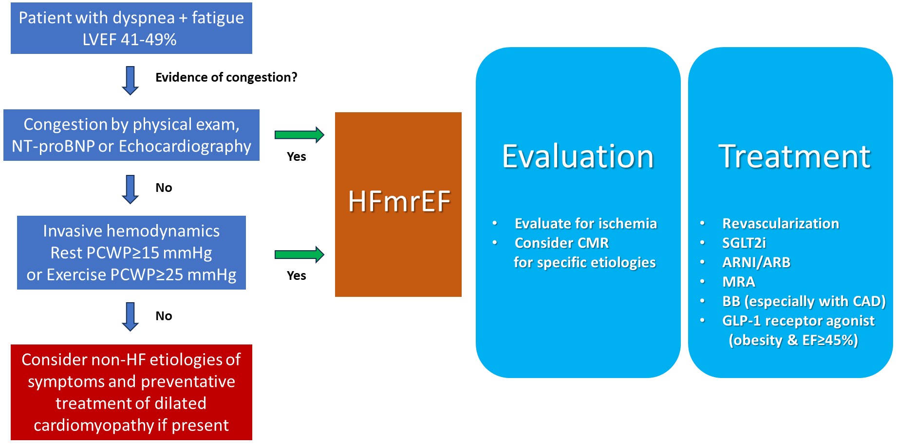
4) Patients with EF 41–49% and symptoms of heart failure should be recognized and followed as having HFmrEF — not left in diagnostic limbo.
Figure 4.

Slide 8
5) SGLT2 inhibitors demonstrate consistent benefit across the EF spectrum, including HFmrEF, with a significant reduction in HF hospitalization or cardiovascular death in more than 4,000 HFmrEF participants across EMPEROR-Preserved and DELIVER-HF (HR 0.78; 95% CI 0.67–0.90).
Excerpt from Table 1: Summary of Trial Evidence of Therapy in HFmrEF
Therapeutic category | Clinical Endpoints | Hazard or rate ratio (95% CI) | Guideline recommendation
SGLT2 inhibitors DELIVER (dapagliflozin) EMPEROR-Preserved (empagliflozin) SOLOIST-WHF (sotagliflozin) | CV death or HHF CV death or HHF CV death or HHF | 0.87 (0.72-1.04) 0.71 (0.57-0.88) 0.72 (0.56-0.94) | 2a (ACC/AHA) 1 (ESC)

Slide 9
6) Guideline-directed medical therapy established for HFrEF — including beta-blockers, ACEi/ARB/ARNI, and MRAs — is appropriate for HFmrEF, supported by subgroup and post-hoc analyses across multiple trials.
Excerpt from Table 1: Summary of Trial Evidence of Therapy in HFmrEF
Therapeutic category | Clinical Endpoints | Hazard or rate ratio (95% CI) | Guideline recommendation
Beta blockers (meta-analysis) | CV death CV death or CV hospitalization | 0.48 (0.24-0.97) 0.83 (0.60-1.13) | 2b
RAAS blockade CHARM program (candesartan) PARAGON-HF (sacubitril/valsartan) PARAGLIDE-HF (sacubitril/valsartan) | CV death or HHF Recurrent HHF CV death or HHF Total HHF NT-pro-BNP change CV death, HHF, urgent HF visit | 0.76 (0.61-0.96) 0.48 (0.33-0.70) 0.89 (0.73-1.10) 0.77 (0.58-1.02) 0.85 (0.73-0.99) 1.19 win ratio (0.93-1.52) | 2b
MRA TOPCAT Americas (spironolactone) FINEARTS (finerenone) | CV death, HHF, or ACA HHF CV death CV death or HHF HHF CV death | 0.55 (0.33-0.91) 0.60 (0.32-1.10) 0.46 (0.23-0.94) 0.84 (0.68-1.03) 0.83 (0.65-1.06) 0.85 (0.65-1.11) | 2b

Slide 10
7) Ischemic heart disease is both common (~50–60%) and prognostically important in HFmrEF; evaluation for ischemia and consideration of revascularization may alter EF trajectory and outcomes, but further study is needed.
Ischemic Heart Disease Prevalence is Around
50-60%

Slide 11
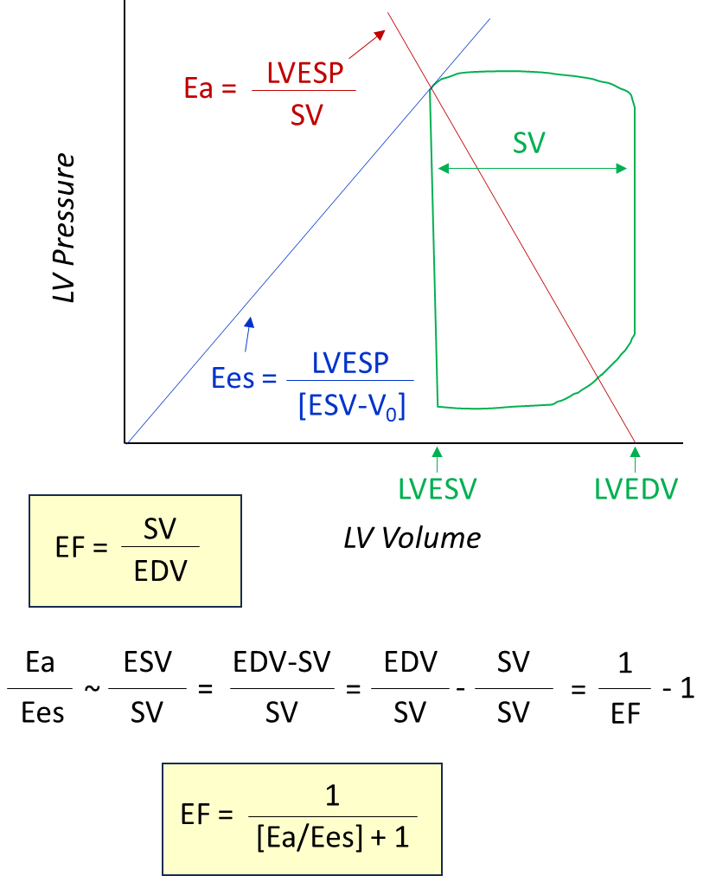
8) EF alone is an imperfect measure of myocardial function — assessment should consider chamber remodeling, afterload, ischemic burden, and comorbidities.
Figure 2.

Slide 12
9) Phenotype-specific approaches matter: obesity-related HFmrEF may benefit from GLP-1–based therapies; infiltrative and genetic cardiomyopathies require targeted management beyond standard GDMT.
Excerpt from Figure 4

Slide 13
10) HFmrEF remains under-studied and under-recognized. Dedicated clinical trials and refined phenotyping are urgently needed to advance the evidence base for this growing patient population.
Excerpt from Table 2: Knowledge Gaps and Future Directions in HFmrEF
Knowledge Gap | What is known related to this Knowledge Gap | Potential resource needed to fill Gap and aid in decision making
Is HFmrEF simply a milder form of HFrEF, an intermediate state, or a transition state? | Shared characteristics of ischemic heart disease and neurohormonal activation in both HFmrEF and HFrEF. Early genetic dilated cardiomyopathy can present with HFmrEF. HFmrEF has lower NP levels and better outcomes than HFrEF | Registry data describing the natural history and trajectory analysis of HFmrEF. Improved phenotyping (imaging, biomarker, etc) in clinical trials. Clinical trials or cohorts with genetic data made publicly available for analysis.
What are the evidence-based treatments for HFmrEF? | SGLT2/1i is the category with best evidence across spectrum of all HF MRAs are beneficial but it remains unclear if newer non-steroidal MRAs are safer or more effective than older steroidal MRAs ARB/ARNI shows benefit in subgroup analysis Semaglutide may be beneficial for patients with obesity and HFmrEF | Future clinical trials more inclusive (e.g. EF >40% in HFpEF trials, and/or EF<50% HFrEF trials) , preferably with EF class stratification, pre-specified sub-group analyses, and adequate sample sizes to better estimate efficacy and safety in HFmrEF.

