Slide 1


Redefining Heart Failure Prevention: Key Insights from the HFSA–ASPC Joint Statement
The Continuum of Prevention and Heart Failure in Cardiovascular Medicine: A Joint Statement from the Heart Failure Society of America and the American Society for Preventive Cardiology

Slide 2
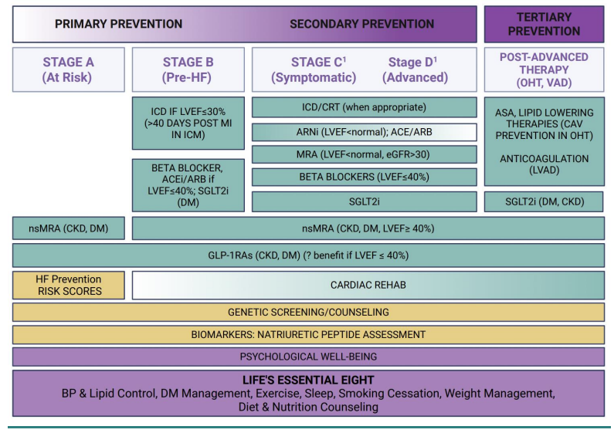
Prevention must be central to heart failure care across the lifespan
This HFSA–ASPC joint statement provides a framework for incorporating heart failure prevention from early risk identification (Stage A) through advanced disease (Stage D) and post-transplant care. It redefines prevention as a continuous strategy, not a one-time intervention.

Slide 3
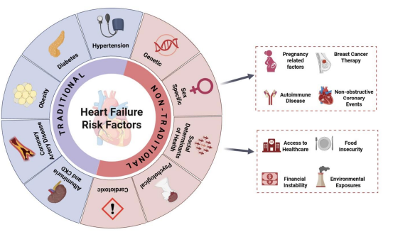
Expanding the Risk Lens: Traditional and Non-Traditional Contributors to Heart Failure
The HFSA–ASPC joint statement broadens the definition of heart failure risk by incorporating both traditional factors, such as hypertension, diabetes, and obesity, and non-traditional risks, including sex-specific, social, genetic, psychological, and cardiotoxic factors. This comprehensive approach underscores the need for personalized and equitable prevention strategies.

Slide 4
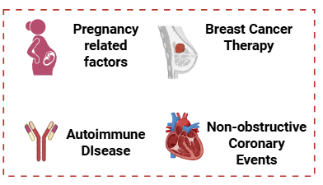
Sex-Specific Risk Factors Deserve Greater Attention in Heart Failure Prevention
The HFSA–ASPC statement highlights often-overlooked contributors to heart failure, including pregnancy-related complications, breast cancer therapy, autoimmune diseases, and non-obstructive coronary events, underscoring the need for tailored prevention in women.

Slide 5
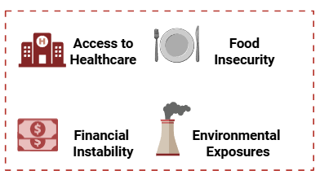
Social Determinants are underrecognized drivers of heart failure risk
The HFSA–ASPC statement emphasizes that barriers like limited healthcare access, food insecurity, financial instability, and environmental exposures must be addressed to achieve equitable heart failure prevention.

Slide 6
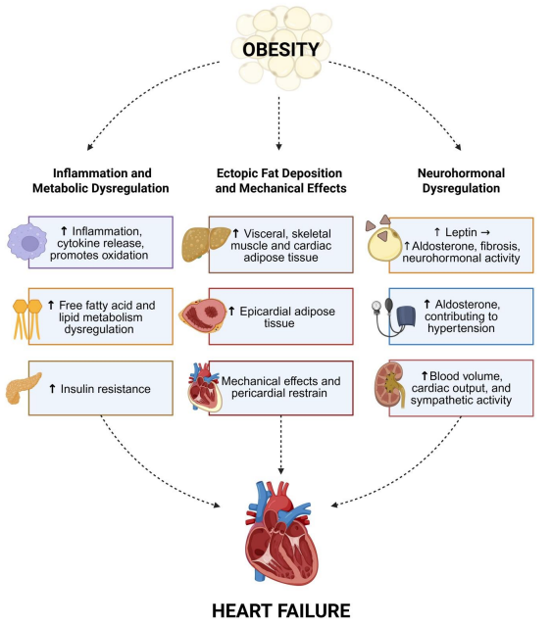
Recognizing Obesity as a Central Mechanism in Heart Failure Development
The HFSA–ASPC joint statement highlights obesity as a central, modifiable driver of heart failure, acting through metabolic, mechanical, and neurohormonal pathways. By targeting obesity early, clinicians can disrupt multiple disease mechanisms.

Slide 7
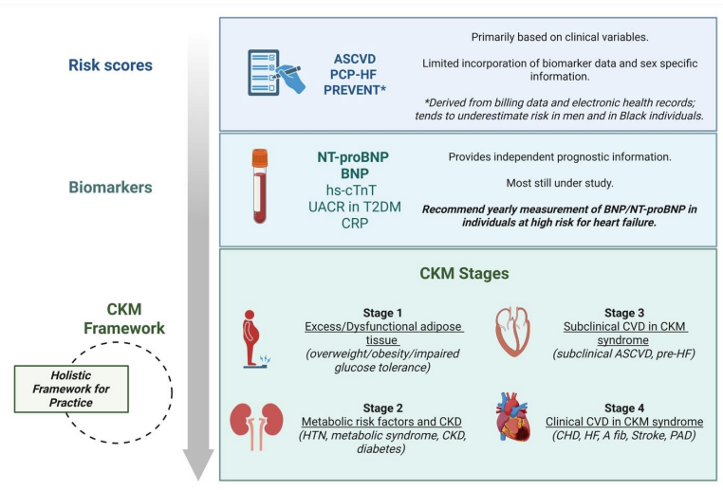
Integrating Risk Tools and the CKM Framework for Heart Failure Prevention
This statement highlights the growing evidence supporting risk scores and biomarker screening.

Slide 8
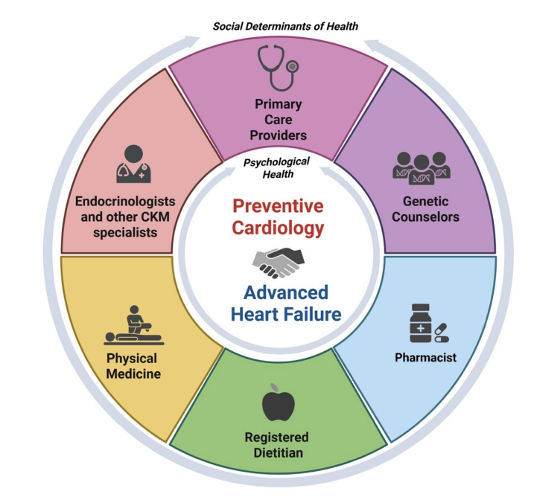
A multidisciplinary, team-based model is essential for meaningful HF prevention.
The statement calls for care models that integrate preventive cardiology and advanced heart failure with primary care, endocrinology, genetic counseling, physical medicine, pharmacy, and nutrition. It also emphasizes the importance of psychological health and social determinants of health in guiding personalized prevention strategies.

