Slide 1

Integration of Palliative Care into Heart Failure Care: Consensus-Based Recommendations from the Heart Failure Society of America
S. Chuzi, et al. J Card Fail 2024

Slide 2
Top 10 Take-Home Messages
Palliative care is medical care for patients with serious illness that aims to enhance quality of life and assist with complex decision-making
Palliative care interventions improve disease-specific quality of life, symptom control, and caregiver burden among patients with HF
HF clinicians should be skilled in providing primary palliative care with competence in basic domains including management of physical and psychosocial symptoms and serious illness communication
Referral to specialty palliative care is indicated for certain patient subsets; ideally, palliative care specialists have familiarity with complex HF care
Impactful palliative care models maximize alignment of available clinical resources with the clinical needs of the population served

Slide 3
Top 10 Take-Home Messages (2/2)
Programmatic structure and process measures should be used to define quality of care provided by integrated HF-palliative care programs
Additional measures that programs can use to measure the quality of HF-palliative care include those related to clinical quality, satisfaction, access, and healthcare utilization
HF clinicians should understand reimbursement mechanisms for performing palliative care services
Integrated HF-palliative care teams should promote optimal communication with and referral to hospice agencies
Recommendations are provided for the provision of palliative care to special populations (adult congenital heart disease, left ventricular assist device, heart transplant)

Slide 4
Key Terms and Definitions
Term | Definition
Palliative Care | Medical care for people with serious illness that focuses on preventing and relieving suffering and enhancing quality of life at all stages of disease
Primary Palliative Care | Basic palliative skills and care that can be provided by clinicians (e.g. generalists, subspecialists) without specialty palliative care training
Specialty Palliative Care | Advanced palliative skills and care that are provided by clinicians with additional palliative care training
Serious Illness Communication | Communication that aims to understand a patient with serious illness’s disease understanding prognostic awareness, values, goals, and preferences in order to guide both current and future care. The patient is provided with clear information about prognosis as well as a treatment recommendation that is aligned with their goals and values.
Advance Care Planning | A process by which individuals understand and share their values, goals, and preferences regarding future, potential medical care decisions. This includes choosing and preparing a trusted person(s) to make medical decisions, and documenting wishes. This is considered distinct from “in-the-moment” decision-making.
Advance Directive | A document appointing an agent and/or recording the wishes of a patient pertaining to his/her future medical treatment should he/she lack decision-making capacity
Hospice Care | A service model that provides a structure and reimbursement mechanism for end-of-life care to patients with an estimated prognosis of 6 months or less.

Slide 5
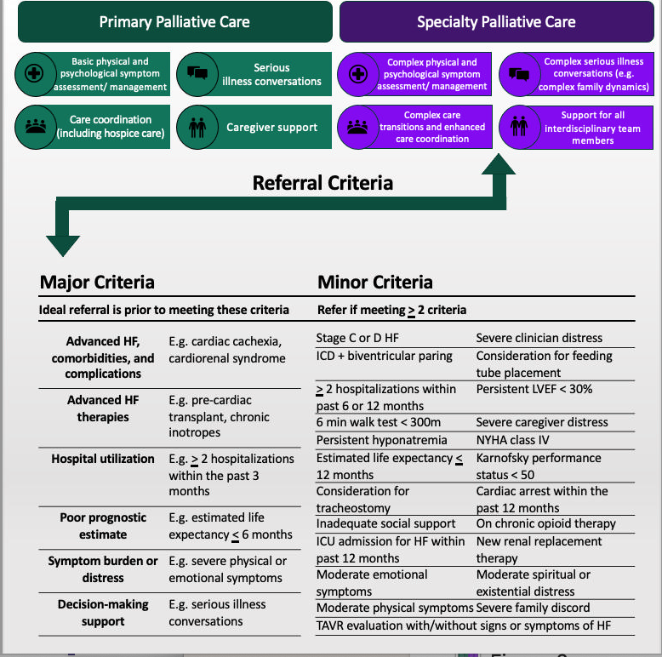
Primary and Specialty Palliative Care Skills and Referral Criteria
Referral Criteria to Specialty Palliative Care

Slide 6
Core and Ideal Components of Integrated Heart Failure-Palliative Care
 | Core | Ideal
Clinical Considerations | HF clinicians are competent in primary PC domains. HF clinicians serially assess for, document, and manage primary PC needs. HF clinicians understand when to refer to specialty PC (if available). | HF clinicians deliver, interpret, monitor, and optimize HF-specific and PC-specific PRO instruments. The specialty PC team has expertise treating patients across the spectrum of HF and familiarity with the complexities of advanced HF interventions (“specialty-aligned PC”).
Operational Considerations | The organizational, logistical, and administrative aspects of the specialty PC team align with local resources to reach the most patients in inpatient and ambulatory settings The specialty PC team is interdisciplinary, representing medicine, nursing, social work, and spiritual care. HF clinicians have an established relationship with local hospice agencies and a robust process for referring and transitioning to hospice care from both inpatient and ambulatory settings. HF and/or PC clinicians communicate consistently and effectively with hospice care teams. | A specialty PC team is available to patients with HF 24 hours per day, 7 days per week. The specialty PC team is integrated into the structure and workflow of the HF program. The HF-PC team caring for patients with HF is interdisciplinary, characterized by close collaboration, regular communication, and a collective/unified approach to care.

Slide 7
Proposed Quality Measures for Integrated Heart Failure-Palliative Care
Category | Metrics
Clinical Quality | PC outcome measures (e.g. FACIT-Pal) are completed serially Serious illness conversations are held at baseline and serially or with new clinical status changes Appropriate counseling is provided regarding the HF illness trajectory and potential upcoming decisions
Satisfaction | Patients report optimal collaboration between specialty PC and HF clinicians Caregivers report adequate support by clinicians
Access | Percentage of patients who reach criteria for specialty PC evaluation who are seen by a PC specialist Time from specialty PC referral to appointment Percentage of HF clinicians trained in PC principles and practices
Utilization | Days alive and out of the hospital Days spent in hospice care Discharges from hospice due to readmission or 911 calls

