Slide 1
Promotional Toolkit
Faculty & Abstract Presenters

Slide 2
Thank you ASM Faculty!
The HFSA Annual Scientific Meeting (ASM) is the foremost event in the field of heart failure – and we couldn’t do it without you! This year’s meeting will be held September 27-30 at the Georgia World Congress Center and the new Signia by Hilton Atlanta in Atlanta, GA. Active participation from HFSA faculty, abstract presenters, and session moderators is pivotal to further heart failure education and training for medical professionals across the globe.​ We not only rely on your expertise and participation, but we also ask that you promote your great work to advance this important event and medical specialty.​ The following toolkit provides a variety of resources you can leverage to help promote your important participation at the ASM.
#HFSA2024

Slide 3
Top 4 Ways to Promote Your Participation in ASM 2024
Plan to share a consistent drumbeat of social media posts leading up to and during the ASM.
Coordinate with your communications department to send out a press release, email, or post in their newsletter about your ASM participation.
Add ASM badges to your email signature to identify yourself as a presenter.
Encourage your colleagues and friends to join you in registering to attend the ASM.
#HFSA2024

Slide 4
Helpful Rules of Thumb
DO promote and reference that you will be attending the HFSA Annual Scientific Meeting (ASM).
DO adhere to all meeting embargo policies.
DON’T capture, transmit, or redistribute data presented at the meeting – this may preclude its later publication in a scientific journal. Adhere to embargo policies and do not jeopardize your colleagues’ work.
DON’T post copyrighted or trademarked material or material protected by other intellectual property rights.
DON’T use HFSA social media platforms to comment on medical, legal, or litigious matters.
DON’T post derogatory, demeaning, inflammatory, offensive, disrespectful, hateful, sales-oriented, or otherwise inappropriate comments.
#HFSA2024

Slide 5
Tips for Successful ASM Social Promotion
Promote your session and ASM registration – When your session is confirmed, promote your participation at the ASM via social media. Let colleagues know you’re registered.
Build interest in your session early – In addition to using your own social media channels to promote your ASM participation, coordinate with your organization’s communications department to promote your session as well.
One month out – increase your promotion – Start talking about what attendees can look forward to during your session at the ASM. You can even consider engaging in some pre-session Q&As to drive interest.
Don’t forget to post live from the ASM – Share your favorite experiences and sessions while at the ASM.
Use multimedia in your posts – Ask colleagues to take photos and video to share and bring your session alive online.
Always use the hashtag #HFSA2024 – This makes finding and re-sharing your content easy for everyone.
#HFSA2024

Slide 6
Jump Into ASM Social Media
Follow and share your ASM participation on Twitter. Include #HFSA2024 to make your posts easy to find and retweet.
Follow us on Twitter: twitter.com/HFSA
Follow and share your ASM participation on LinkedIn. Include #HFSA2024 to make your posts easy to find and share.
Follow us on LinkedIn: linkedin.com/company/hfsa
#HFSA2024

Slide 7
ASM 2024 Logos
#HFSA2024

Slide 8
Sample Social Media Posts - Speakers
Speakers
It’s official! I’m speaking at #HFSA2024 in Atlanta September 27-30. ADD SESSION NAME/DETAILS Register at HFSA.org/ASM2024
I’m speaking at #HFSA2024 in Atlanta September 27-30. Don’t miss my session ADD SESSION NAME/DETAILS. Go to HFSA.org/ASM2024 to register. ​
Atlanta is the place to be from September 27-30! Don’t miss my session SESSION NAME at #HFSA2024. Register now to meet me there: HFSA.org/ASM2024 ​
Pair posts with social media graphics found in the shared folder. If you have trouble accessing these graphics, contact marketing@hfsa.org.
Put screenshot in this space
#HFSA2024

Slide 9
Sample Social Media Posts - Abstract
Abstract Presenters
It’s official! I’m presenting my research at #HFSA2024 in Atlanta September 27-30. Visit me in the ePoster Hub to learn about RESEARCH DETAILS. Register at HFSA.org/ASM2024
I’m presenting my research during an Oral Abstract session at #HFSA2024 in Atlanta September 27-30. Don’t miss my session on RESEARCH DETAILS on date. Go to HFSA.org/ASM2024 to register. ​
Atlanta is the place to be from September 27-30! Don’t miss the chance to learn about my research on RESEARCH DETAILS SESSION NAME at #HFSA2024. Register now to meet me there: HFSA.org/ASM2024
Pair posts with social media graphics found in the shared folder. If you have trouble accessing these graphics, contact marketing@hfsa.org.
Put screenshot in this space
#HFSA2024

Slide 10
Sample Press Release Content
FOR IMMEDIATE RELEASE​
NAME is Presenting [A SESSION/THEIR RESEARCH] on [DETAILS] at ​the Heart Failure Society of America Annual Scientific Meeting 2024
​
CITY, STATE (DATE) - Today, the Heart Failure Society of America (HFSA) announced the selection of NAME, TITLE/ORGANIZATION to SPEAK/PRESENT at the upcoming HFSA Annual Scientific Meeting (ASM) 2024. This preeminent annual event – taking place from September 27-30, 2024– brings together the world’s leading experts to advance the treatment of heart failure . This year’s ASM will be hosted at the Georgia World Congress Center and the new Signia by Hilton Atlanta in Atlanta, GA.
NAME will share DETAILS ON SPEECH/RESEARCH TOPIC [during a session entitled SESSION NAME] [in the ePoster Hub], which will take place on DATE/TIME/LOCATION OF SESSION. The world’s heart failure teams gather together at the HFSA ASM to immerse themselves in the latest science, research and practical management, while taking advantage of opportunities to connect with colleagues at networking events, in the exhibit hall and during much-anticipated award ceremonies.​
QUOTE FROM NAME ABOUT THE IMPORTANCE/RELEVANCE OF THE SESSION/CONTENT. ​
Follow ORGANIZATION NAME on X via YOUR HASHTAG and the HFSA ASM via #HFSA2024.​
About the Heart Failure Society of America
The Heart Failure Society of America, Inc. (HFSA) represents the first organized effort by heart failure experts from the Americas to provide a forum for all those interested in heart function, heart failure, and congestive heart failure (CHF) research and patient care. The mission of HFSA is to provide a platform to improve and expand heart failure care through collaboration, education, innovation, research, and advocacy. HFSA members include physicians, scientists, nurses, nurse practitioners, pharmacists, trainees, other healthcare workers and patients. For more information, visit hfsa.org. For more information about the HFSA Annual Scientific Meeting, visit hfsa.org/asm2024.
Put screenshot in this space
#HFSA2024

Slide 11
Sample Email to Your Colleagues
Here’s a sample message to alert friends and colleagues to your upcoming ASM session:​
​
Colleagues,​
​
I am thrilled to share that the Heart Failure Society of America (HFSA) Annual Scientific Meeting will take place in Atlanta, Georgia, September 27-30 – and I'm SPEAKING IN A SESSION/PRESENTING MY RESEARCH.​
​
My session, SESSION TITLE, takes place on DATE/TIME. I hope you will join me in Atlanta and spread the word by encouraging your colleagues and friends to participate as well.​
​
Registration for the event is open. Go to: hfsa.org/asm2024
​
See you in Atlanta! ​
​ Your name​
Pair posts with social media graphics found in the shared folder. If you have trouble accessing these graphics, contact marketing@hfsa.org.
Put screenshot in this space
#HFSA2024

Slide 12
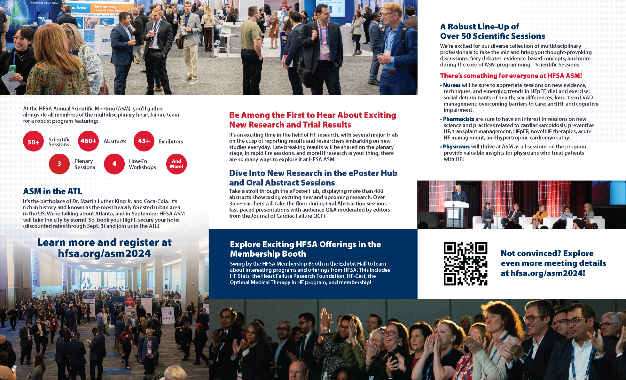
Downloadable Brochure
Download a shareable brochure from the ASM website!
Put screenshot in this space
#HFSA2024

Slide 13
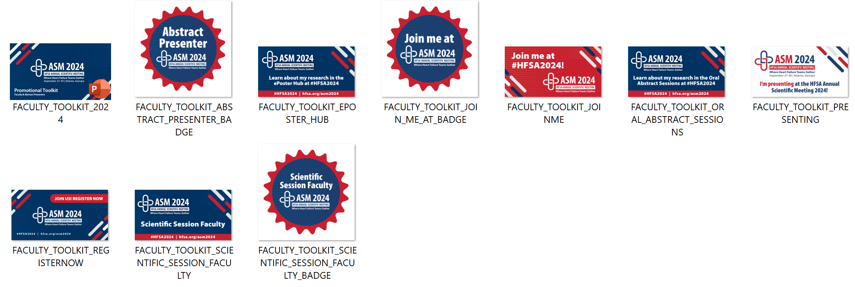
Downloadable Graphics
All social media graphics can be found in this shared folder. If you have trouble accessing these graphics, contact marketing@hfsa.org.
Put screenshot in this space
#HFSA2024

Slide 14
Seeking additional materials?
If you’re looking for additional materials to help promote your involvement in the HFSA Annual Scientific Meeting 2024, please contact the marketing staff: Aly Altonen – aaltonen@hfsa.org Erica Nieves – enieves@hfsa.org Laura Poko – lpoko@hfsa.org

