Slide 1
Promotional Toolkit
Exhibitors & Sponsors

Slide 2
Thank you Exhibitors & Sponsors!
The HFSA Annual Scientific Meeting (ASM) is the best venue in the field of heart failure to showcase your company’s products/services and expand your brand visibility. HFSA sponsors and exhibitors, like you, make pivotal contributions to further heart failure education and training for medical professionals across the globe. We not only rely on your expertise and participation, but we also ask that your organization promote your great work to advance this important event and medical specialty.​ The following toolkit provides a variety of resources your organization can leverage to help promote your important support and participation at the ASM.
#HFSA2024

Slide 3
Helpful Rules of Thumb
• DO promote and reference that you will be attending the HFSA Annual Scientific Meeting (ASM).
• DON’T welcome HFSA ASM attendees in your social media posts.
• DON’T capture, transmit, or redistribute data presented at the meeting – this may preclude its later publication in a scientific journal. Adhere to embargo policies and do not jeopardize your colleagues’ work.
• DON’T post copyrighted or trademarked material or material protected by other intellectual property rights.
• DON’T use HFSA social media platforms to comment on medical, legal, or litigious matters.
• DON’T post derogatory, demeaning, inflammatory, offensive, disrespectful, hateful, sales-oriented, or otherwise inappropriate comments.
#HFSA2024

Slide 4
Top 4 Ways to Promote Your Participation in ASM 2024
Plan to share a consistent drumbeat of social media posts leading up to and during the ASM.
Coordinate with your communications department to send out a press release, email, or post in their newsletter about your ASM participation.
Add ASM badges to your email signature to identify yourself as a sponsor or exhibitor.
Encourage your colleagues, friends, and other contacts to join you in registering to attend the ASM.
#HFSA2024

Slide 5
Tips for Successful ASM Social Promotion
• Start your social promotion as soon as possible – This helps build interest in your participation early, leading to greater awareness by the time of the event. No need to post heavily early on, but it’s great to kick-start the excitement and build post frequency as the meeting gets closer.
• Plan your social media effort during the event – Who will be attending from your organization? Can they partner with your communications department to help promote your organization’s participation?
• One month out – increase your promotion – Start talking about what attendees can look forward to at the ASM. Tease new products, breaking research, demonstrations, raffles, etc.
• Don’t forget to post live from the ASM – Posting as things happen adds excitement to your promotional effort and gives you more opportunities to capitalize on and showcase what’s happening onsite.
• Use multimedia in your posts – Photos and videos bring your ASM participation alive online. The more interesting you can make your posts – both content-wise and visually, the more effective they will be.
• Always use the hashtag #HFSA2024 – This makes finding and re-sharing your content easy for everyone.
#HFSA2024

Slide 6
Jump Into ASM Social Media
Follow and share your ASM participation on Twitter. Include #HFSA2024 to make your posts easy to find and retweet.
Follow us on Twitter: twitter.com/HFSA
Follow and share your ASM participation on LinkedIn. Include #HFSA2024 to make your posts easy to find and share.
Follow us on LinkedIn: linkedin.com/company/hfsa
#HFSA2024

Slide 7
ASM 2024 Logos
#HFSA2024

Slide 8
Sample Social Media Posts
!COMPANY NAME! is a proud sponsor of #HFSA2024! Join us in Atlanta, GA September 27-30 as we connect with the leading experts in #heartfailure. Go to hfsa.org/asm2024 to register.
!COMPANY NAME! is exhibiting at #HFSA2024 – where #heartfailure teams gather! Register now & come check us out in !BOOTH NUMBER! Go to: hfsa.org/asm2024
Where will you be September 27-30, 2024? We’ll be showing our stuff in-person at #HFSA2024. Don’t miss us at !BOOTH NUMBER!. Register at hfsa.org/asm2024 to join in. #heartfailure #cardiotwitter
Atlanta, GA is the place to be from September 27-30! COMPANY NAME is a proud !SPONSOR/EXHIBITOR! of #HFSA2024 where #heartfailure teams gather. Register now to meet us there: hfsa.org/asm2024
We’re excited to see you in Atlanta, GA from September 27-30 for #HFSA2024! COMPANY NAME is excited to SPONSOR/EXHIBIT at this year's meeting. Don’t miss the latest in #heartfailure – register now at hfsa.org/asm2024
Pair posts with social media graphics found in this shared folder. If you have trouble accessing these graphics, contact marketing@hfsa.org.
Put screenshot in this space
#HFSA2024

Slide 9
Sample Press Release - Sponsor
FOR IMMEDIATE RELEASE
ORGANIZATION NAME to Sponsor the Heart Failure Society of America Annual Scientific Meeting 2024
CITY, STATE (DATE)-ORGANIZATION NAME , COMPANY BOILERPLATE, today announced its SPONSORSHIP TYPE at the Heart Failure Society of America (HFSA) Annual Scientific Meeting 2024, which will bring together the world’s leading experts in heart failure from September 27-30, 2024 at the Georgia World Congress Center and the new Signia by Hilton Atlanta in Atlanta, GA.
As the SPONSOR TYPE, ORGANIZATION NAME will INSERT SPONSORSHIP DETAILS during ASM 2024.
The world’s heart failure teams gather at the HFSA Annual Scientific Meeting to immerse themselves in the latest science, research, and practical management, while taking advantage of opportunities to connect with colleagues at networking events, in the exhibit hall, and during much-anticipated award ceremonies.
QUOTE FROM ORGANZIATION LEADERSHIP ABOUT THE IMPORTANCE/RELEVANCE OF THE SPONSORSHIP.
Follow ORGANIZATION NAME on X via YOUR HASHTAG and the HFSA ASM via #HFSA2024.
###
About the Heart Failure Society of America
The Heart Failure Society of America, Inc. (HFSA) represents the first organized effort by heart failure experts from the Americas to provide a forum for all those interested in heart function, heart failure, and congestive heart failure (CHF) research and patient care. The mission of HFSA is to provide a platform to improve and expand heart failure care through collaboration, education, innovation, research, and advocacy. HFSA members include physicians, scientists, nurses, nurse practitioners, pharmacists, trainees, other healthcare workers and patients. For more information, visit hfsa.org. For more information about the HFSA Annual Scientific Meeting, visit hfsa.org/asm2024.
Put screenshot in this space
#HFSA2024

Slide 10
Sample Press Release - Exhibitor
FOR IMMEDIATE RELEASE
ORGANIZATION NAME to Exhibit at the Heart Failure Society of America Annual Scientific Meeting 2024
-OR- ORGANIZATION NAME to Showcase TECHNOLOGY, INITIATIVE OR SOLUTION in BOOTH NUMBER
CITY, STATE (DATE)-ORGANIZATION NAME , COMPANY BOILERPLATE, today announced it will exhibit at the at the Heart Failure Society of America (HFSA) Annual Scientific Meeting 2024, which will bring together the world’s leading experts in heart failure from September 27-30, 2024 at the Georgia World Congress Center and the new Signia by Hilton Atlanta in Atlanta, GA.
ORGANIZATION NAME will deliver a dynamic exhibit space during ASM 2024.
The world’s heart failure teams gather at the HFSA Annual Scientific Meeting to immerse themselves in the latest science, research, and practical management, while taking advantage of opportunities to connect with colleagues at networking events, in the exhibit hall, and during much-anticipated award ceremonies.
QUOTE FROM ORGANZIATION LEADERSHIP ABOUT THE IMPORTANCE OF PARTICIPATING IN THE ASM.
Follow ORGANIZATION NAME on X via YOUR HASHTAG and the HFSA ASM via #HFSA2024.
###
About the Heart Failure Society of America
The Heart Failure Society of America, Inc. (HFSA) represents the first organized effort by heart failure experts from the Americas to provide a forum for all those interested in heart function, heart failure, and congestive heart failure (CHF) research and patient care. The mission of HFSA is to provide a platform to improve and expand heart failure care through collaboration, education, innovation, research, and advocacy. HFSA members include physicians, scientists, nurses, nurse practitioners, pharmacists, trainees, other healthcare workers and patients. For more information, visit hfsa.org. For more information about the HFSA Annual Scientific Meeting, visit hfsa.org/asm2024.
Put screenshot in this space
#HFSA2024

Slide 11
Sample Blog Post - Sponsor
We are Proud to Sponsor the HFSA Annual Scientific Meeting 2024
ORGANIZATION NAME is proud to sponsor the Heart Failure Society of America (HFSA) Annual Scientific Meeting 2024, which will bring together the world’s leading experts in heart failure from September 27-30, 2024. This year’s ASM will be held at the Georgia World Congress Center and the new Signia by Hilton Atlanta in Atlanta, GA - and we'll be there!
The world’s heart failure teams gather together at the HFSA Annual Scientific Meeting to immerse themselves in the latest science, research, and practical management, while taking advantage of opportunities to connect with colleagues at networking events, in the exhibit hall, and during much-anticipated award ceremonies.
Follow ORGANIZATION NAME on X via YOUR HASHTAG and the HFSA ASM via #HFSA2024.
Put screenshot in this space
#HFSA2024

Slide 12
Sample Blog Post - Exhibitor
Visit Our Booth at the the HFSA Annual Scientific Meeting 2024 – OR – Stop by Our Booth at the the HFSA Annual Scientific Meeting 2024
ORGANIZATION NAME is proud to exhibit at the Heart Failure Society of America (HFSA) Annual Scientific Meeting 2024, which will bring together the world’s leading experts in heart failure from September 27-30, 2024. This year’s ASM will be held at the Georgia World Congress Center and the new Signia by Hilton Atlanta in Atlanta, GA - and we'll be there!
Stop by and visit us in BOOTH NUMBER to learn about PRODUCT OR SERVICE.
The world’s heart failure teams gather together at the HFSA Annual Scientific Meeting to immerse themselves in the latest science, research, and practical management, while taking advantage of opportunities to connect with colleagues at networking events, in the exhibit hall, and during much-anticipated award ceremonies.
Follow ORGANIZATION NAME on X via YOUR HASHTAG and the HFSA ASM via #HFSA2024.
Put screenshot in this space
#HFSA2024

Slide 13
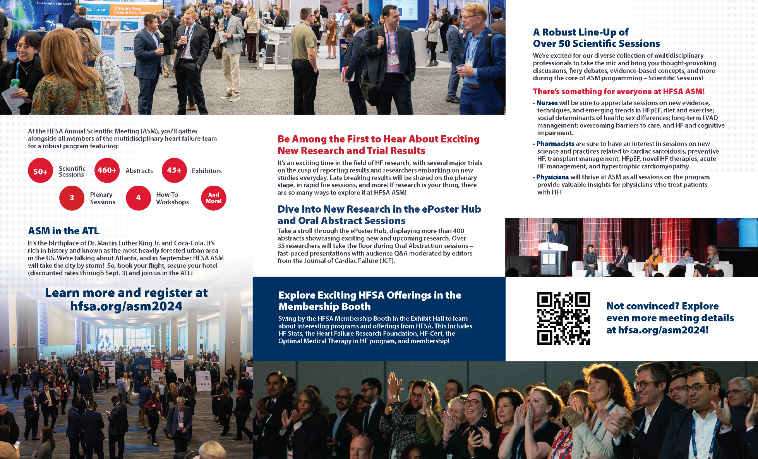
Downloadable Brochure
Download a shareable brochure from the ASM website!
Put screenshot in this space
#HFSA2024

Slide 14
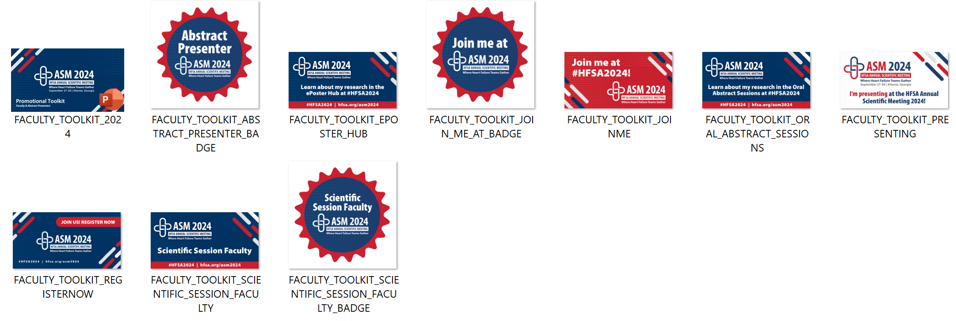
Downloadable Graphics
All social media graphics can be found in this shared folder. If you have trouble accessing these graphics, contact marketing@hfsa.org.
Put screenshot in this space
#HFSA2024

Slide 15
Seeking additional materials?
If you’re looking for additional materials to help promote your involvement in the HFSA Annual Scientific Meeting 2024, please contact the marketing staff: Aly Altonen – aaltonen@hfsa.org Erica Nieves – enieves@hfsa.org Laura Poko – lpoko@hfsa.org

