Slide 2
Promotional Toolkit
Faculty and Abstract Presenters

Slide 3
Thank You ASM Faculty!
The HFSA Annual Scientific Meeting (ASM) is the foremost event in the field of heart failure – and we couldn’t do it without you! This year’s meeting offers attendees the ability to safely join us in-person in Washington, DC, or choose a simplified version tuning into some livestreamed sessions and accessing others OnDemand – allowing participation from around the world.
Active participation from HFSA faculty, abstract presenters, and session moderators is pivotal to further heart failure education and training for medical professionals all across the globe.
We not only rely on your expertise and participation, we also ask that you promote your great work to advance this important event and medical specialty.
The following toolkit provides a variety of resources you can leverage to help promote your important participation at the ASM.
#HFSA2022
hfsa.org/asm2022

Slide 4
Top 4 Ways to Promote Your Participation in ASM 2022
Plan to share a consistent drumbeat of social media posts leading up to and during the ASM.
Coordinate with your communications department to send out a press release, email, or post in their newsletter about your ASM participation.
Post ASM badges to your email signature to identify yourself as a presenter.
Encourage your colleagues and friends to join you in registering to attend the ASM.
#HFSA2022
hfsa.org/asm2022

Slide 5
Helpful Rules of Thumb
DO promote and reference that you will be in attendance at the HFSA Annual Scientific Meeting (ASM).
DO adhere to all meeting embargo policies.
DON’T capture, transmit, or redistribute data presented at the meeting – this may preclude its later publication in a scientific journal. Adhere to embargo policies and do not jeopardize your colleagues’ work.
DON’T post copyrighted or trademarked material or material protected by other intellectual property rights.
DON’T use HFSA social media platforms to comment on medical, legal, or litigious matters.
DON’T post derogatory, demeaning, inflammatory, offensive, disrespectful, hateful, sales-oriented, or otherwise inappropriate comments.
#HFSA2022
hfsa.org/asm2022

Slide 6
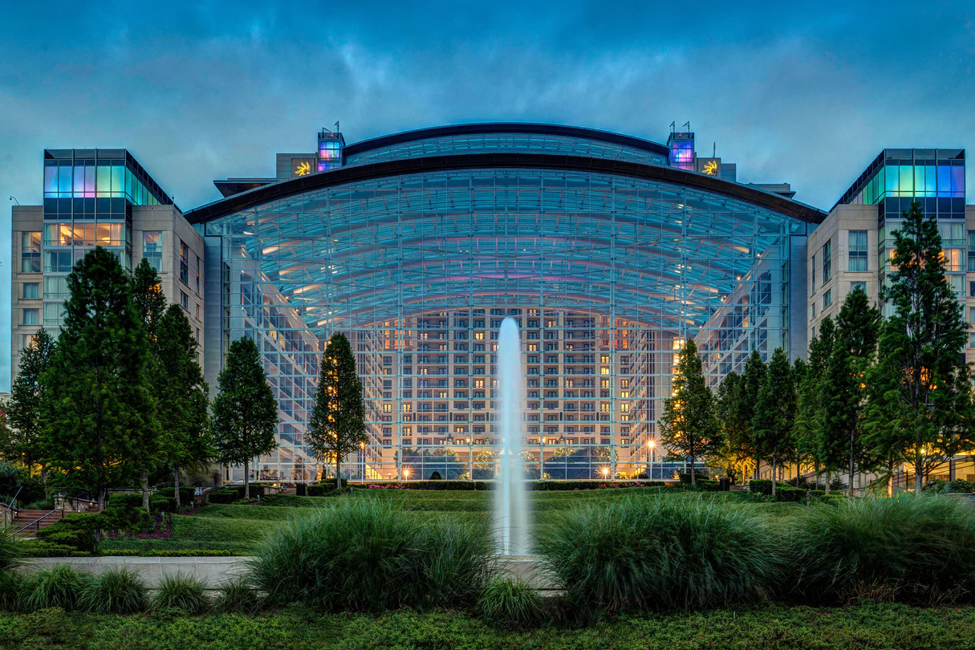
Register to Attend
Go to hfsa.org/asm2022 to register yourself and your team.
Encourage your colleagues and friends to join you in exciting National Harbor, just outside of Washington, DC!
#HFSA2022
hfsa.org/asm2022

Slide 7
Tips for Successful ASM Social Promotion
Promote your session and ASM registration – When your session is confirmed, promote your participation at the ASM via social media. Let colleagues know you’re registered and be sure to use #HFSA2022.
Build interest in your session early – In addition to using your own social media channels to promote your ASM participation, coordinate with your organization’s communication’s department to promote your session as well.
1 month out – step up your promotion – Start talking about what attendees can look forward to during your session at the ASM. You can even consider in engaging in some pre-session Q&As to drive interest.
Don’t forget to post live from the ASM – Share your favorite experiences and sessions while at the ASM.
Use multimedia in your posts – Ask colleagues to take photos and video to share and bring your session alive online.
Always use the hashtag #HFSA2022 – This makes finding and re-sharing your content easy for everyone.
#HFSA2022
hfsa.org/asm2022

Slide 8
Jump Into ASM Social Media
Follow and share your ASM participation on Twitter. Include #HFSA2022 to make your posts easy to find and retweet.
Follow us on Twitter: Twitter.com/HFSA
Follow and share your ASM participation on LinkedIn.
Follow us on LinkedIn:
LinkedIn.com/company/hfsa
#HFSA2022
hfsa.org/asm2022

Slide 9
ASM 2022 Logos
#HFSA2022
hfsa.org/asm2022

Slide 10
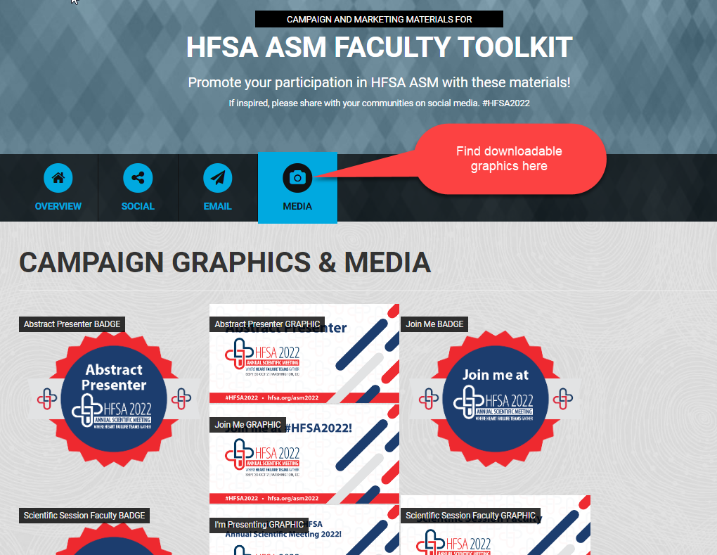
Downloadable Graphics
Find downloadable graphics under the MEDIA TAB, including badges and social media graphics:
https://www.spiralshare.com/share-page/401-HFSA-ASM-Faculty-Toolkit/
#HFSA2022
hfsa.org/asm2022

Slide 11
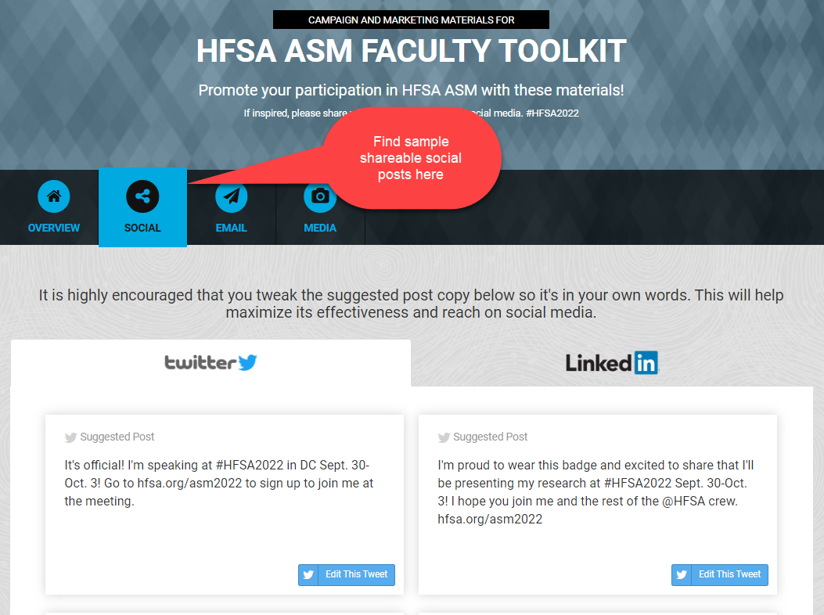
Sample Social Media Posts
Find sample shareable posts under the SOCIAL TAB on the website below. Be sure to edit them to fit your language and then share them directly to your social sites:
https://www.spiralshare.com/share-page/401-HFSA-ASM-Faculty-Toolkit/
#HFSA2022
hfsa.org/asm2022

Slide 12
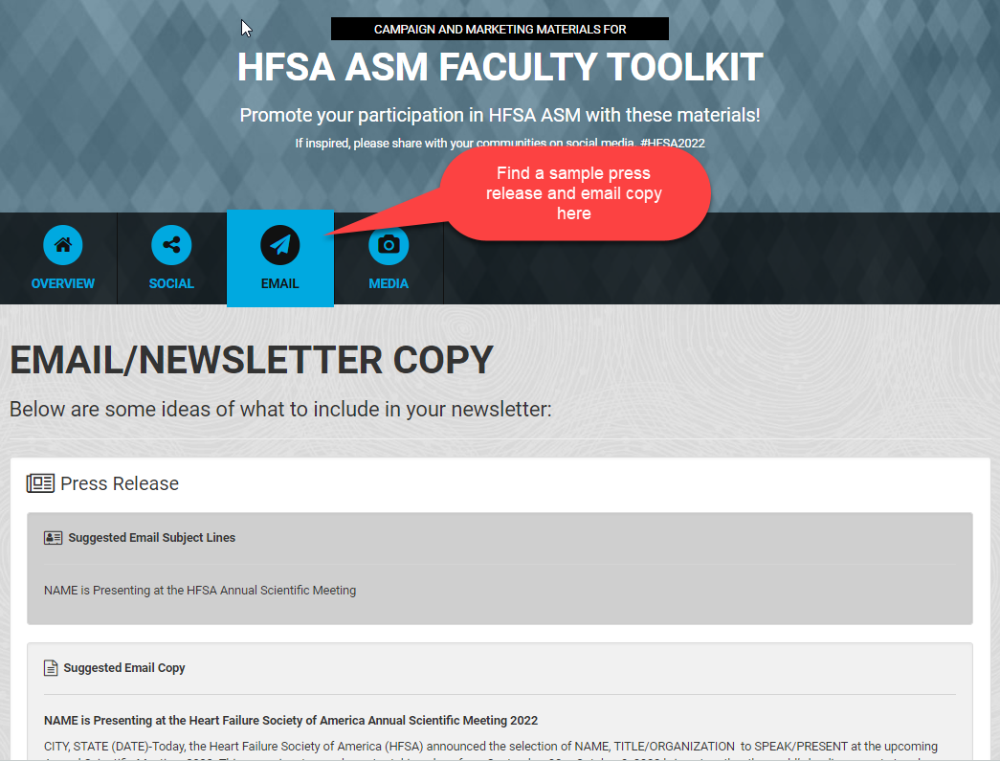
Sample Press Release and Email Content
Find a sample press release and email copy that you or your organization may share on your behalf under the EMAIL TAB:
https://www.spiralshare.com/share-page/401-HFSA-ASM-Faculty-Toolkit/
#HFSA2022
hfsa.org/asm2022

Slide 13
Seeking Additional Materials?
If you’re looking for additional materials to help you promote your involvement in the HFSA Annual Scientific Meeting 2022, please contact marketing staff:
Aly Altonen aaltonen@hfsa.org
Erica Nieves enieves@hfsa.org
Laura Poko lpoko@hfsa.org
#HFSA2022
hfsa.org/asm2022

