Slide 1
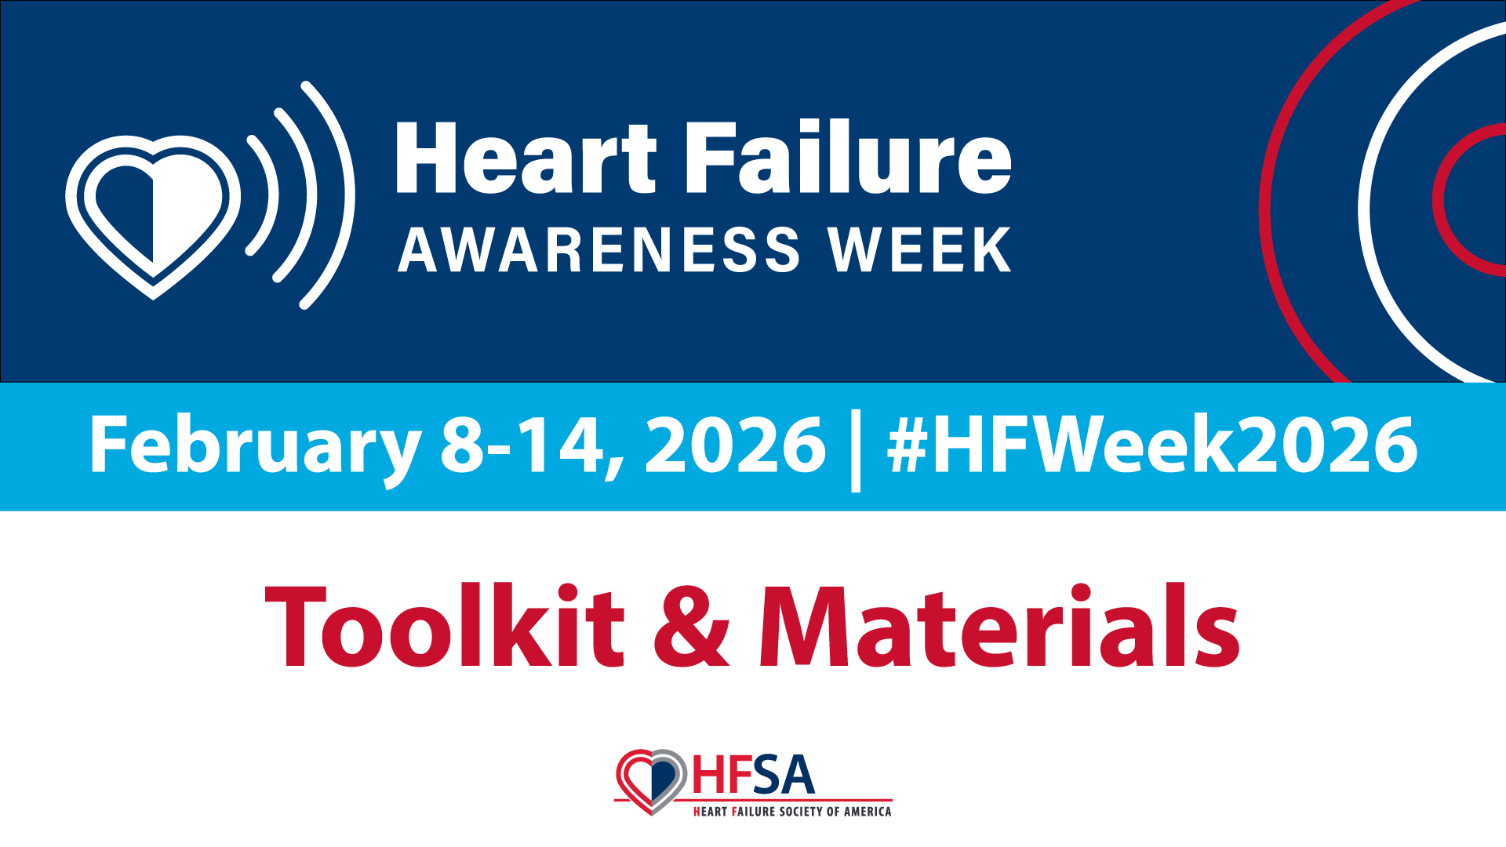

Slide 2




Slide 3


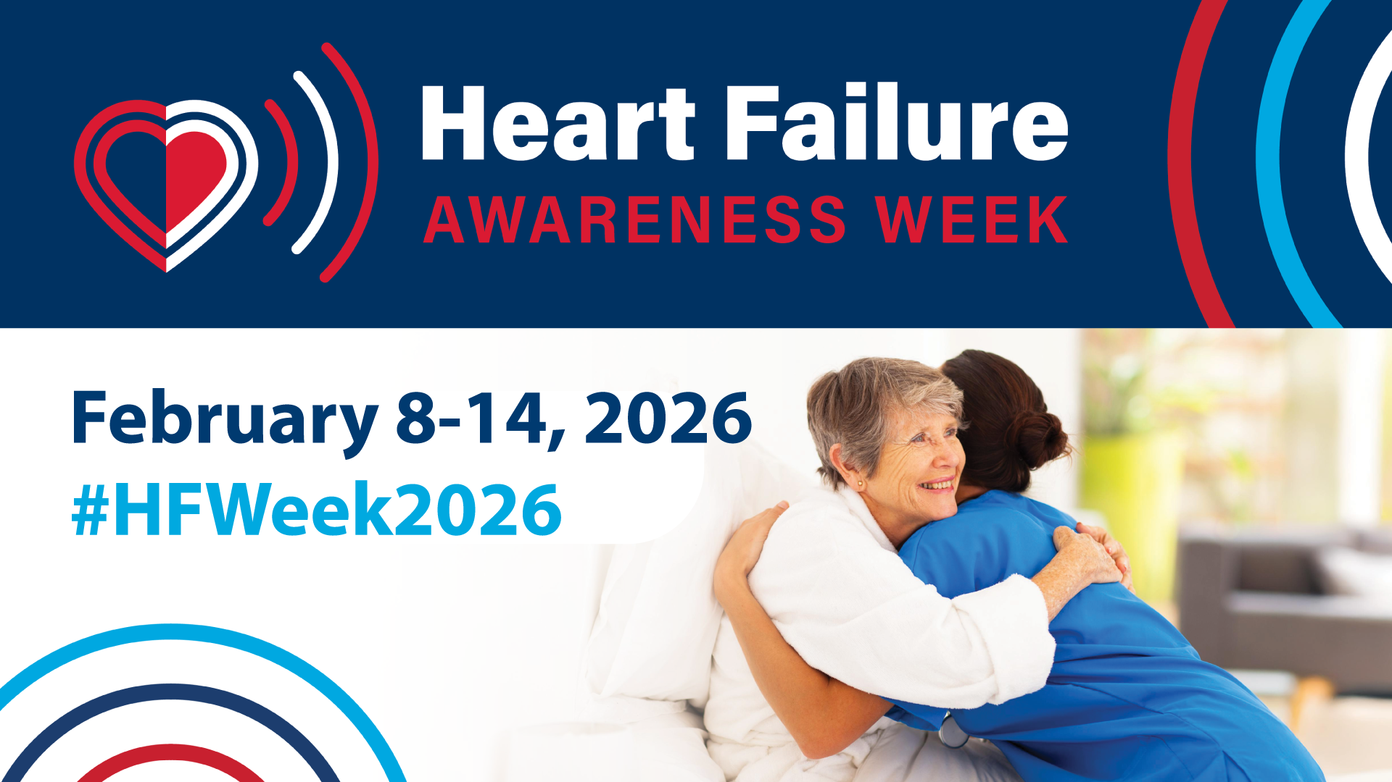
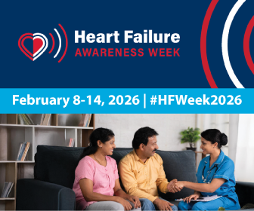

Slide 4
Link to: hfsa.org/hfweek2026
Official Hashtag: #HFWeek2026
Instagram: @heartfailuresociety / Facebook: Heart Failure Society of America – HFSA /
X: @HFSA / LinkedIn: Heart Failure Society of America / Bluesky: @hfsa.bsky.social
Caption Samples:
Heart Failure Awareness Week is Feb. 8-14. Show your support for #heartfailure awareness by joining in the week’s activities, all hosted by HFSA. Follow #HFWeek2026 for details!
Join HFSA and other supporters for #HFWeek2026 Feb. 8-14! By raising awareness about #heartfailure risks, symptoms, and management, we can empower individuals to take proactive steps toward prevention and care. hfsa.org/hfweek2026
With the number of #heartfailure cases expected to rise in the coming years, now, more than ever, raising awareness is essential for building a stronger, healthier community. Join HFSA Feb. 8-14 during #HFWeek2026 to raise awareness! hfsa.org/hfweek2026
Heart Failure Awareness Week is the perfect time to connect with other patients and caregivers experiencing the same challenges and milestones as you. We encourage you to share your story this #HFWeek2026 using #MyHFStory2026.
Did you know that it’s National Heart Failure Awareness Week? Nearly 7 million Americans over 20 years old have heart failure. Someone you love may be at risk. Learn the facts at hfsa.org/hfweek2026 #HFWeek2026
I’ll be sharing resources and info about #heartfailure all week for Heart Failure Awareness Week! Join me! #HFWeek2026 hfsa.org/hfweek2026

Slide 5



